Slide 1

Speed Packing

Slide 2
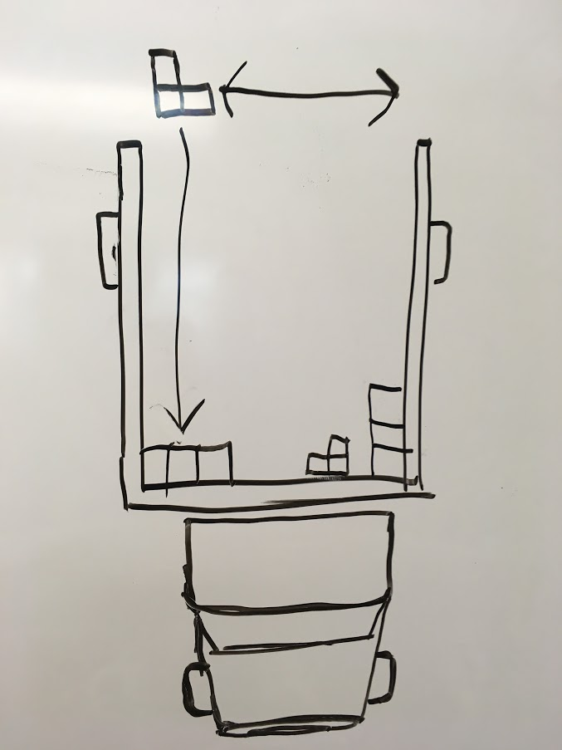

It’s a Game, and it’s Pretty Fun!

